Slide 1
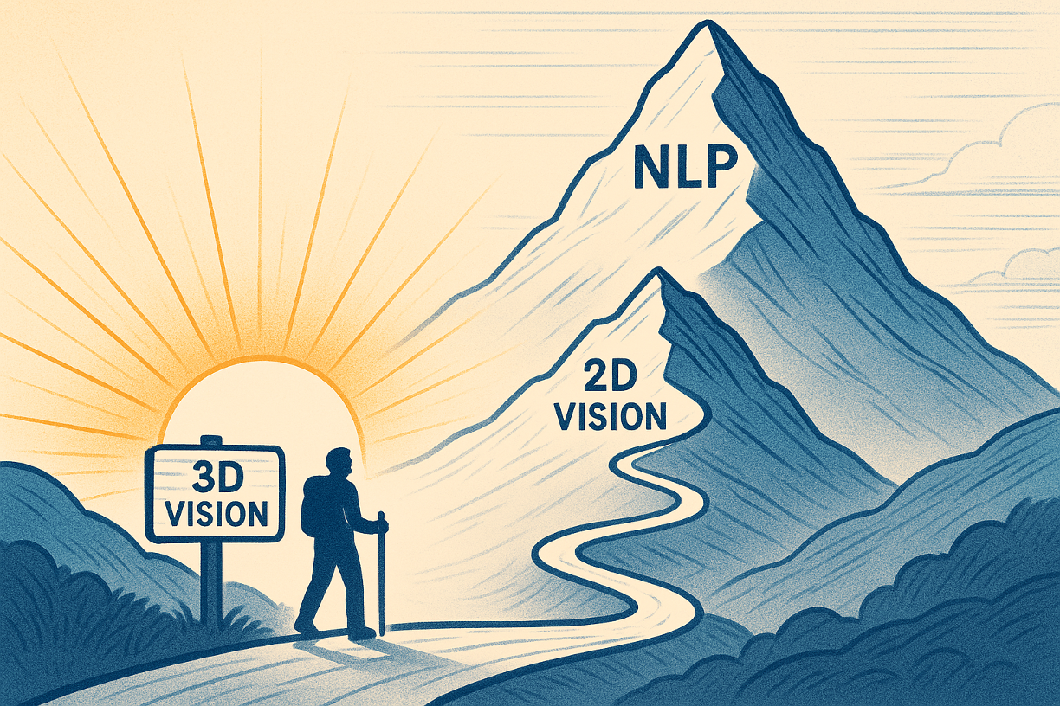

Slide 2
目录
什么是3D重建和新视图生成？
在DL时代：基于传统几何的优化方法还有被大量运用吗

Slide 3
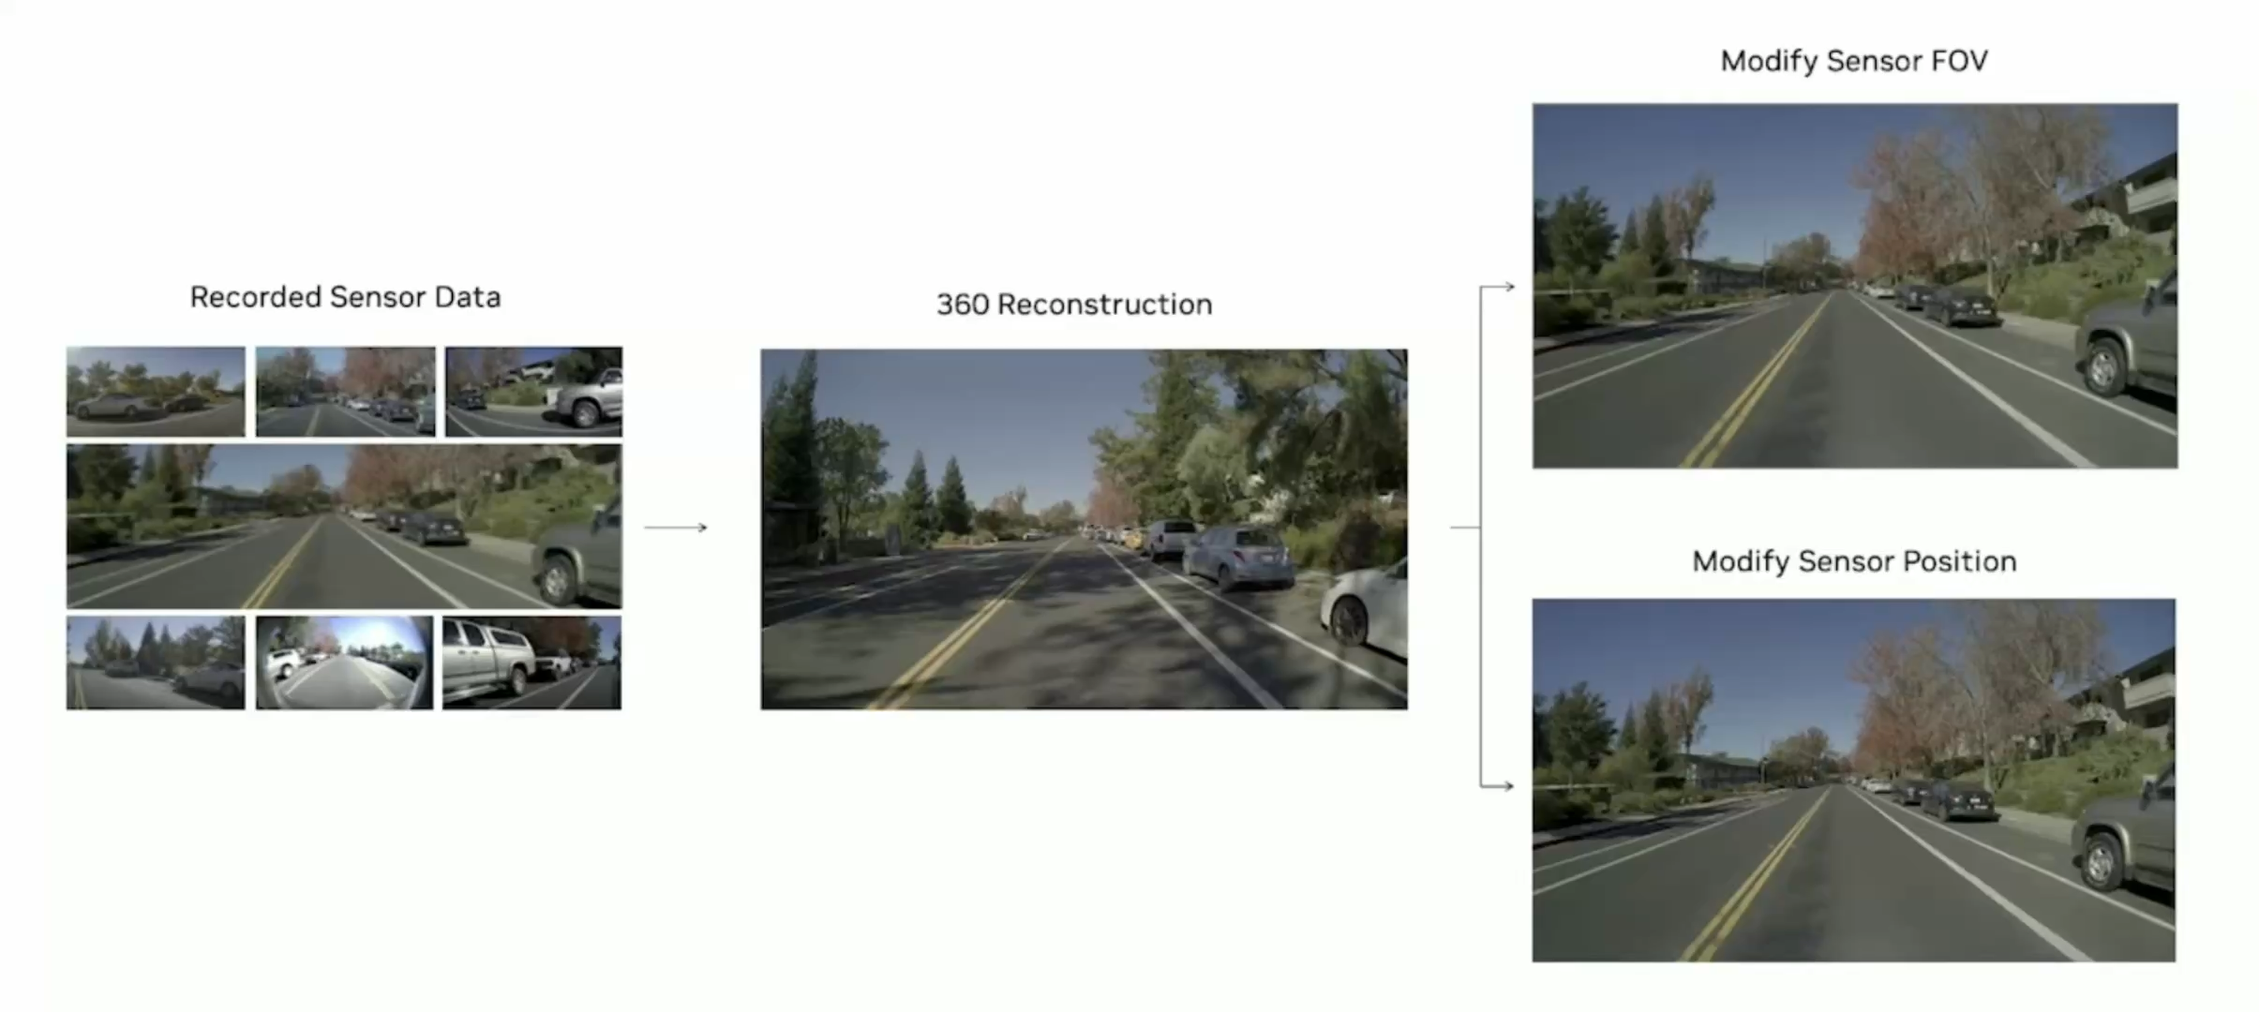
3D reconstruction and NVS
Task: 给定二维观测数据、图像或深度数据，生成物体或场景的三维表示。
输出：同一场景的新视图
（采用 NVS 方法渲染）
输入：场景的稀疏采样图像
Notes:
3D vision的基础任务主要包含重建和NVS

Slide 4
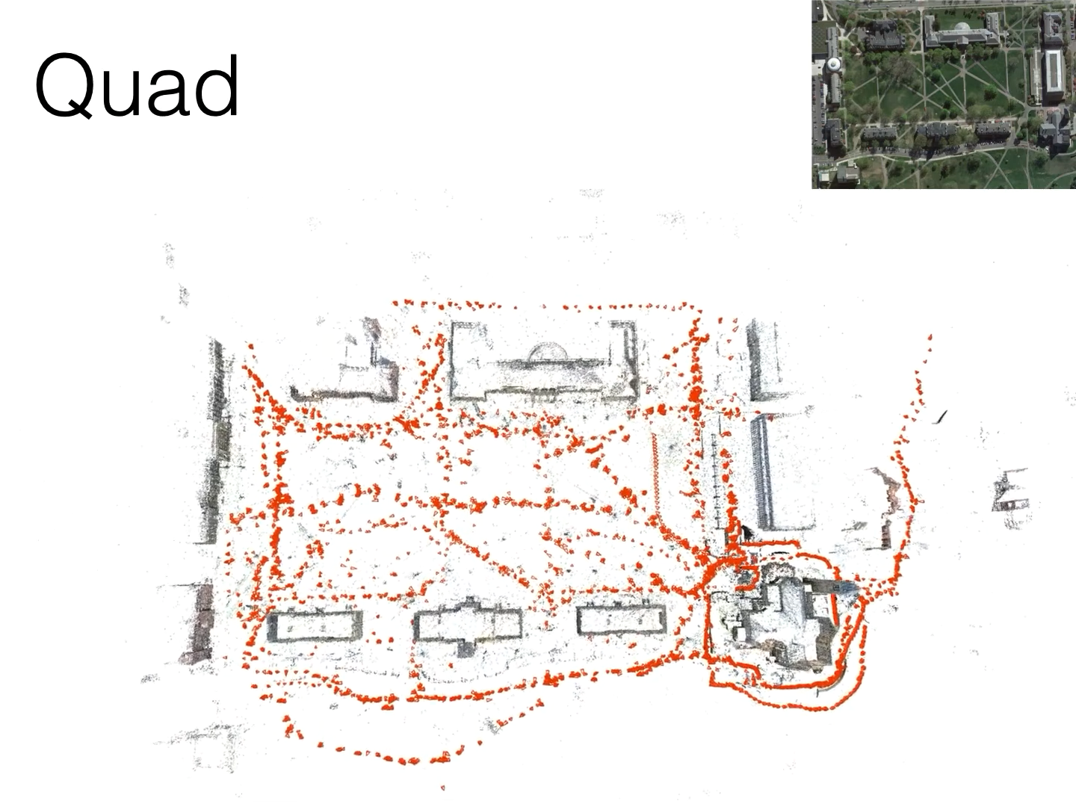
Classical Vision Reconstruction
…
Hartley&Zisserman (2001)
…
PhotoTourism
(2006)
…
COLMAP
(2016)
…
Video Source: COLMAP, Schonberger et al. 2016
Notes:
Hartley&Zisserman (2001):Multi-view geometry 的作者
PhotoTourism (2006)：这项开创性工作利用运动结构重建（SfM）技术来估计相机位置并创建3D模型，实现了照片之间的平滑过渡、3D导航和物体标注
COLMAP (2016):COLMAP 是一个通用的运动结构重建 (SfM) 和多视图立体 (MVS) 流程。

Slide 5
Question: Traditional pipiline gone?
NO! SFM as an initializaztion for neural radiance field, it’s a good inductive bias!

Slide 6
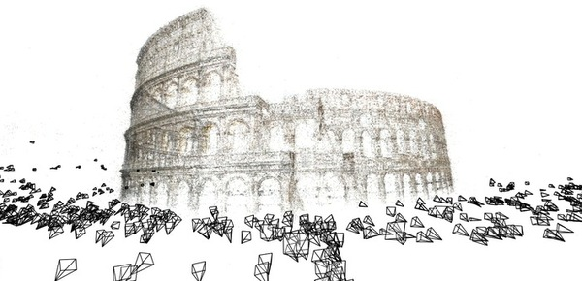
Structure From Motion

Slide 7
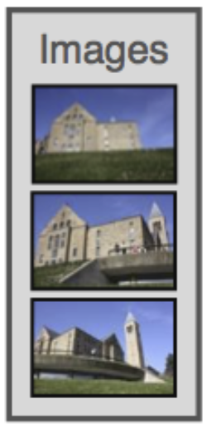
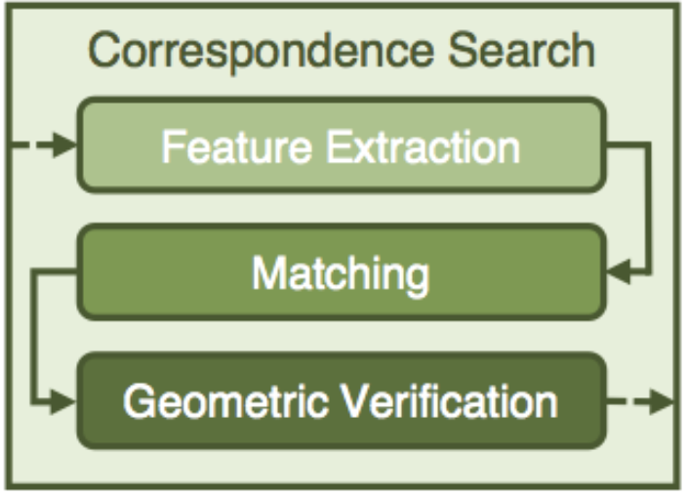
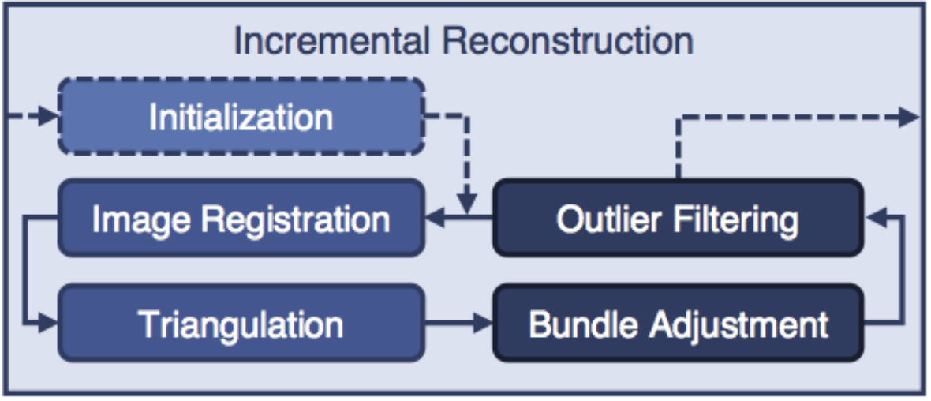
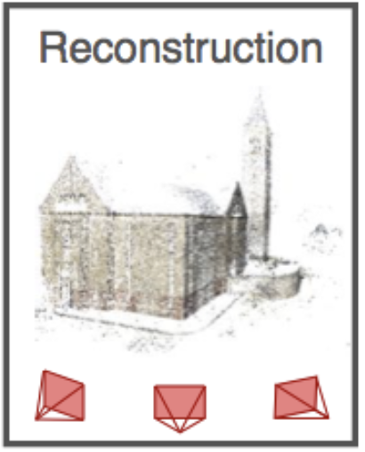
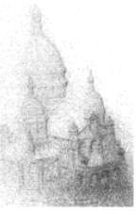
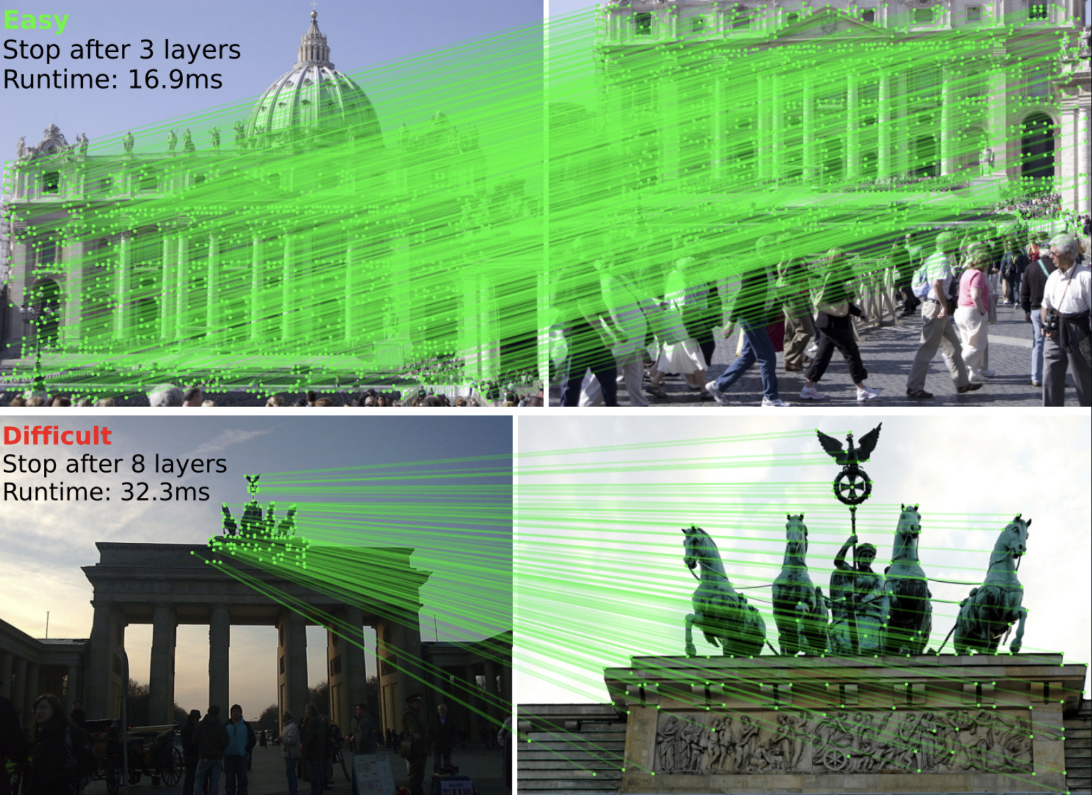
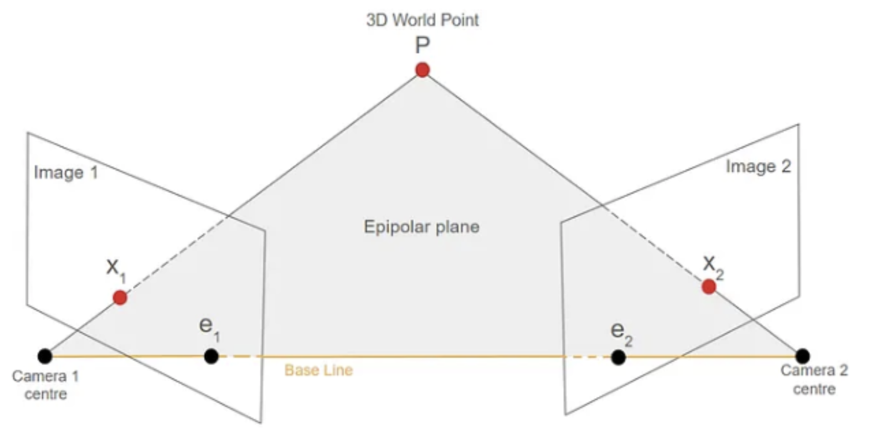
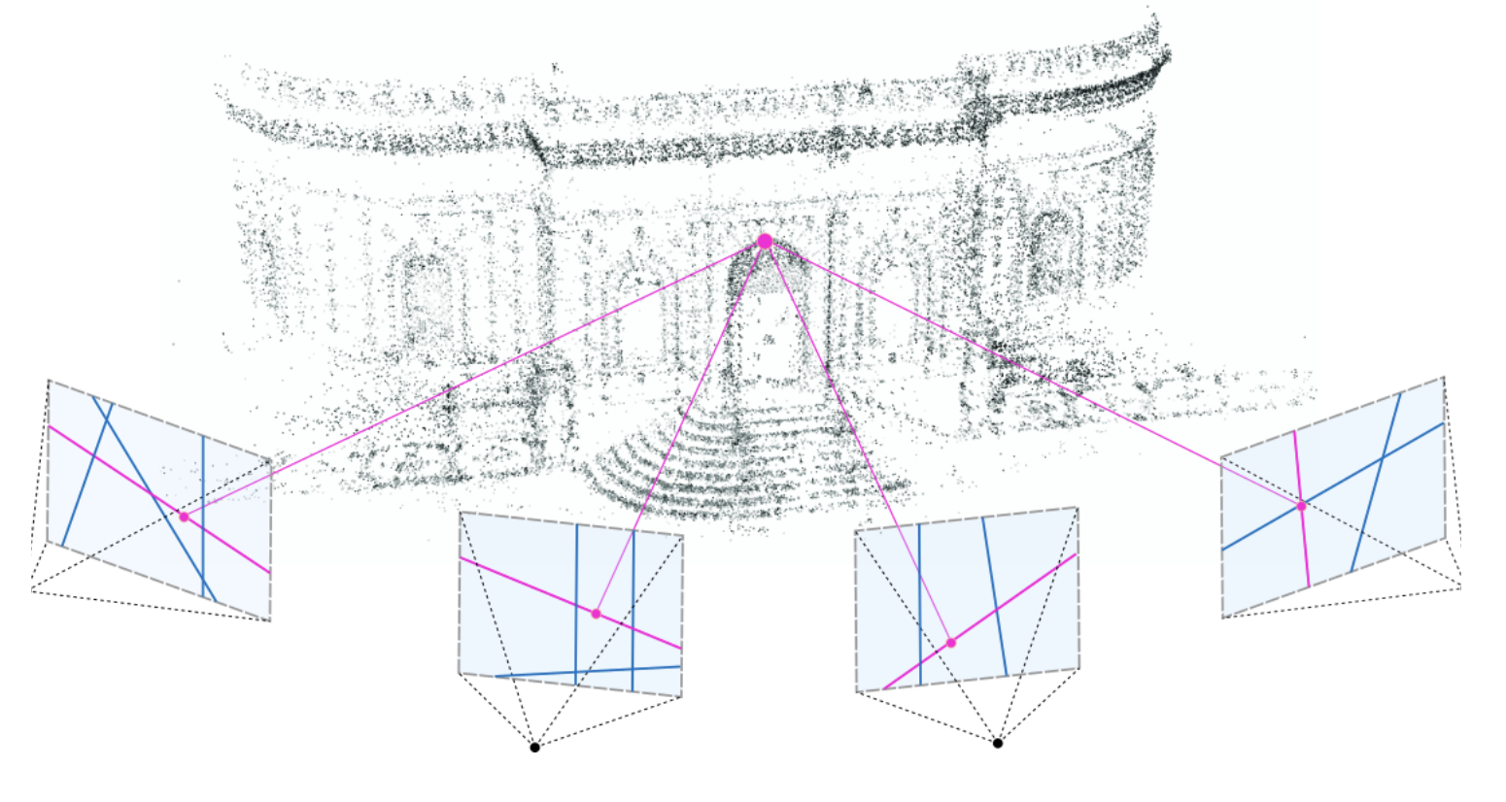
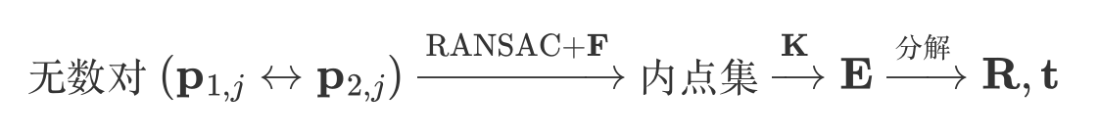
Conventionally: Colmap is the pose estimator
SIFT,ORB….
LightGlue
Schonberger, Johannes L., and Jan-Michael Frahm. "Structure-from-motion revisited." Proceedings of the IEEE conference on computer vision and pattern recognition. 2016.

Slide 8
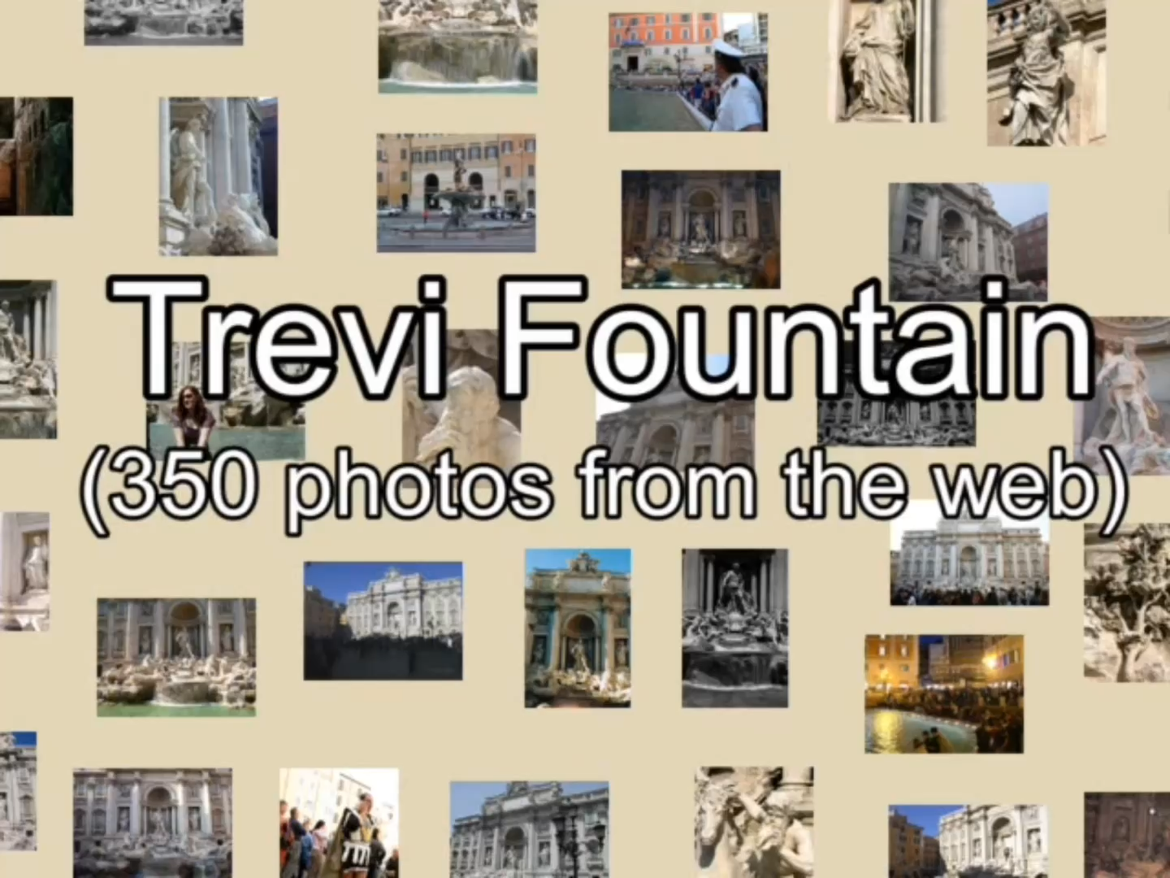
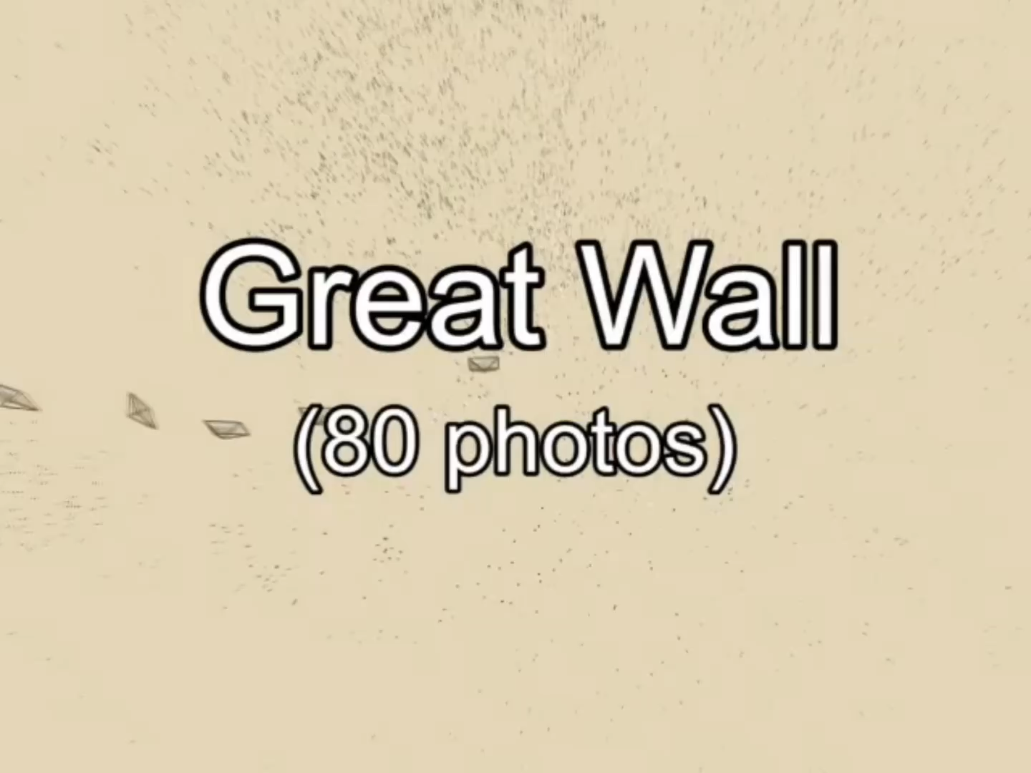
Structure From motion

Slide 9
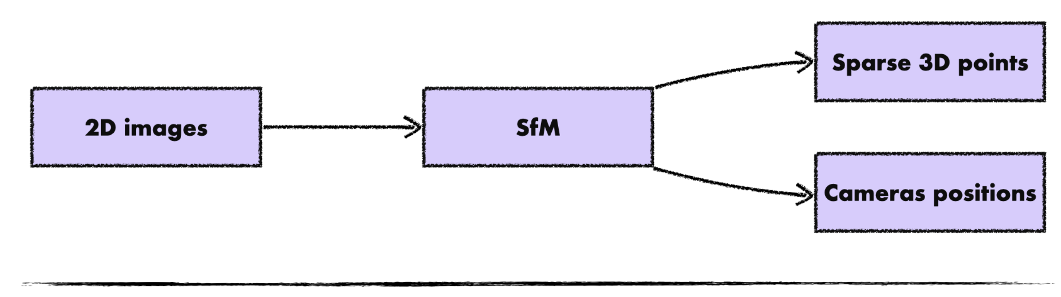
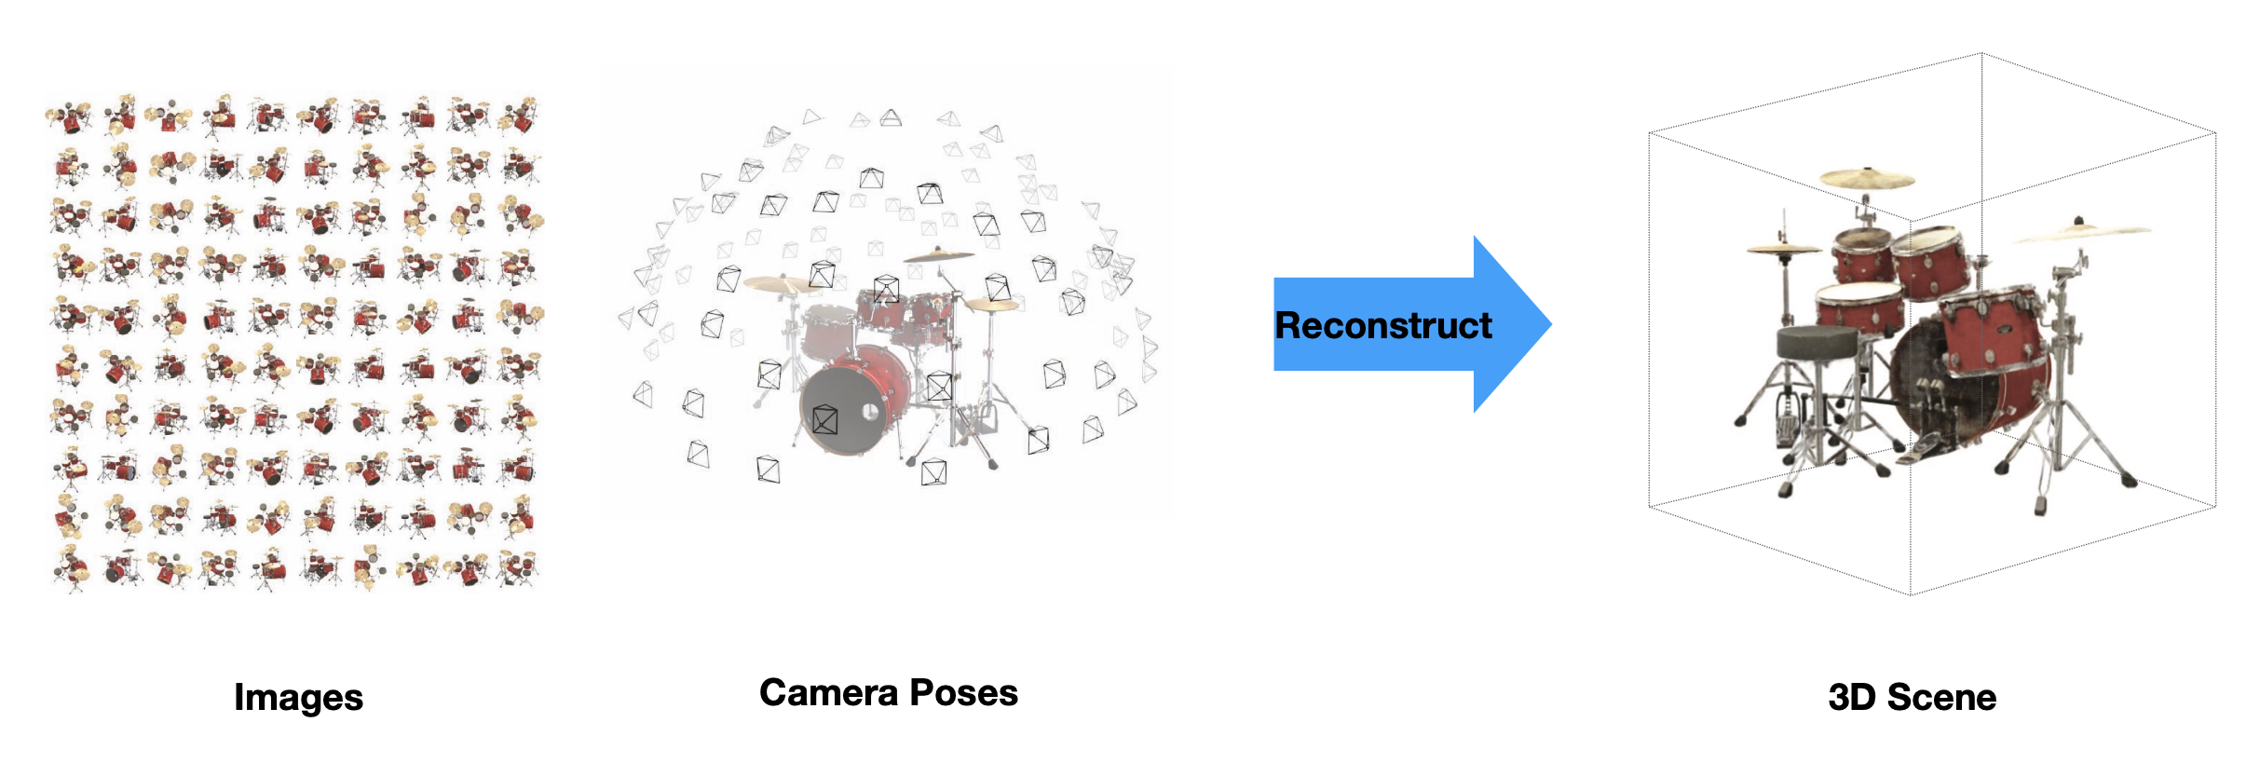
Why we need SFM as initialization in NVS?
Good inductive bias!
Neural radiance field
Mildenhall, Ben, et al. "Nerf: Representing scenes as neural radiance fields for view synthesis." Communications of the ACM 65.1 (2021): 99-106.

Slide 10
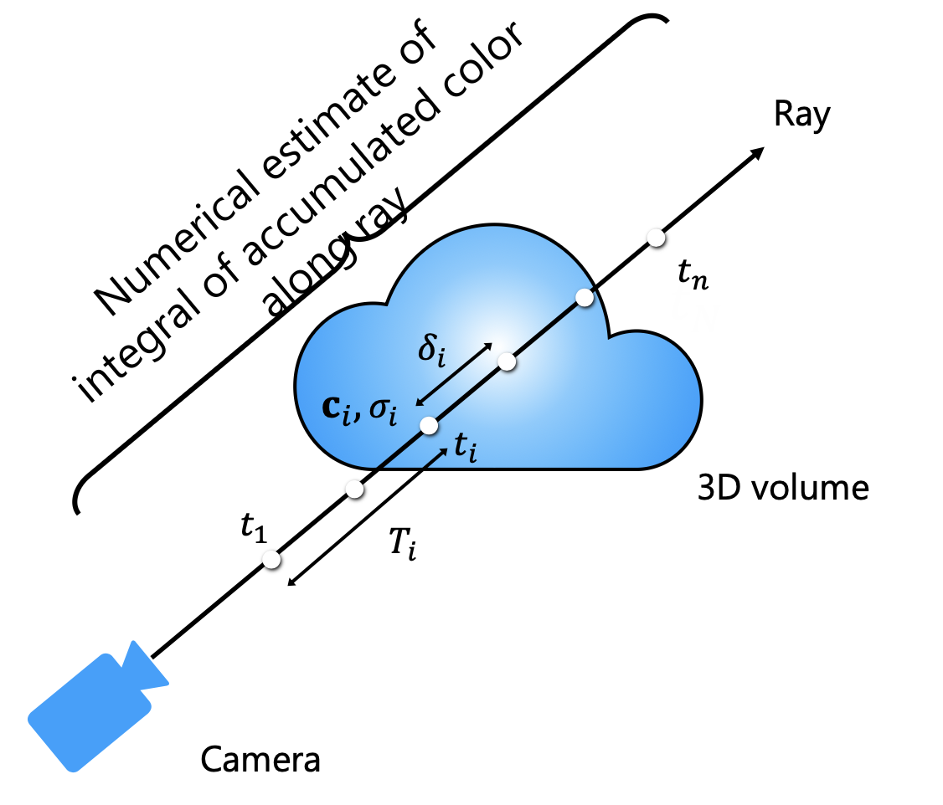
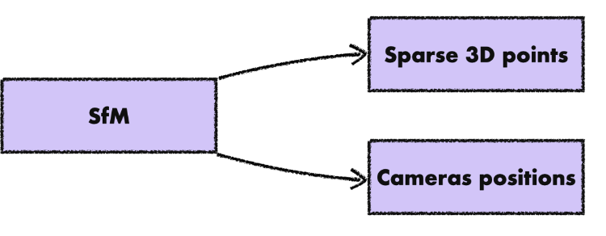
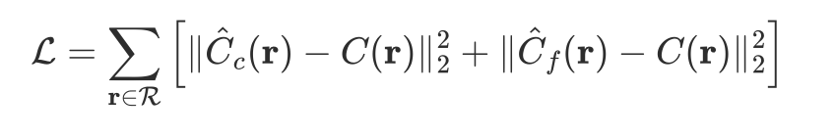

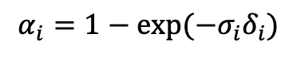
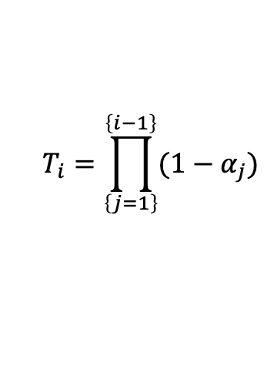
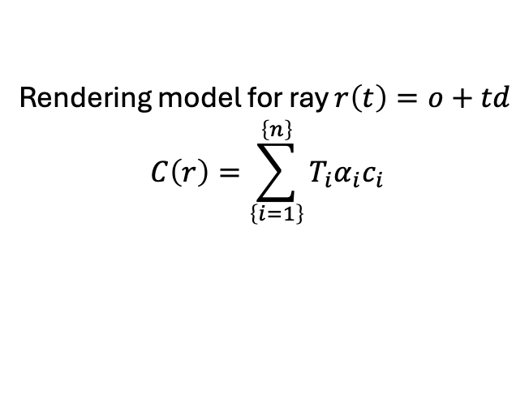
Why we need SFM as initialization in Nerf?
$$α_{i}=1−exp⁡(−σ_{i}δ_{i})$$
$$T_{i}=\prod_{\left\{j=1\right\}}^{\left\{i−1\right\}}{(1−α_{j})}$$
How much light is blocked earlier along the ray
Rendering model for ray $r\left(t\right)=o+td$
$$C\left(r\right)=\sum_{\left\{i=1\right\}}^{\left\{n\right\}}{T_{i}α_{i}c_{i}}$$
Mildenhall, Ben, et al. "Nerf: Representing scenes as neural radiance fields for view synthesis." Communications of the ACM 65.1 (2021): 99-106.

Slide 11
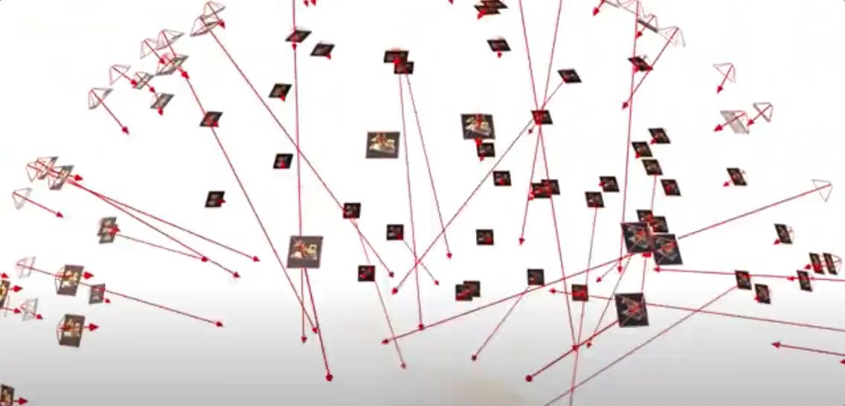
Why we need SFM as initialization in Nerf?
Mildenhall, Ben, et al. "Nerf: Representing scenes as neural radiance fields for view synthesis." Communications of the ACM 65.1 (2021): 99-106.

Slide 12
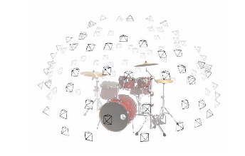
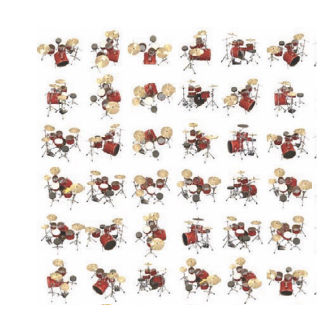
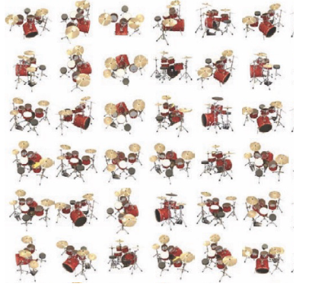
Why we need SFM as initialization in Nerf?
Rendered images
GT images
Implicit volumetirc scene representation
Renderer
-
Optimization via SGD
Supervision signal is weak, and Vinilla nerf network structure is simple(9-layer fully connected net).
So, SFM(inductive bias) is necessary, or it’s gonna be hard to converge.

Slide 13
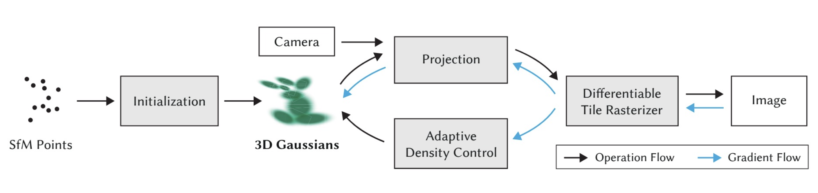
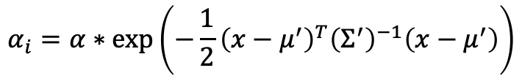
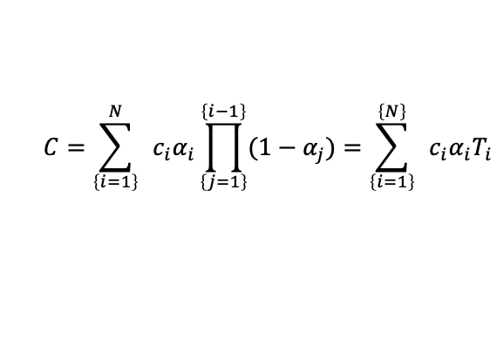
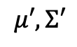
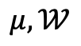
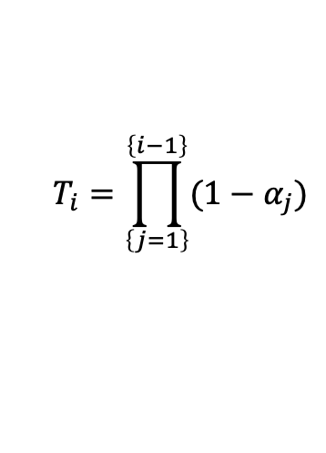
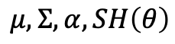
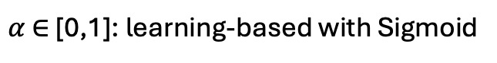
Why we need SFM as initialization in 3DGS?
$$μ,𝒲$$
$$μ,Σ,α,SH\left(θ\right)$$
$$μ′, Σ′$$
$$C=\sum_{\left\{i=1\right\}}^{N}{ }c_{i}α_{i}\prod_{\left\{j=1\right\}}^{\left\{i−1\right\}}{(1−α_{j})=\sum_{\left\{i=1\right\}}^{\left\{N\right\}}{ }c_{i}α_{i}T_{i}}$$
$$ℒ=\left(1−λ\right)ℒ_{1}+λℒ_{D−SSIM}$$
∇$ℒ→\text{∇}𝒞→\text{∇}\text{(}α_{i},c_{i})→\text{∇}\text{(}α,θ,Σ^{′},μ^{′}) →\text{∇}\text{(}Σ\text{,}μ)$
$$T_{i}=\prod_{\left\{j=1\right\}}^{\left\{i−1\right\}}{(1−α_{j})}$$
渲染层面的监督信号
$$α_{i}=α∗\exp\left(−\frac{1}{2}{\left(x−μ^{′}\right)}^{T}{\left(Σ^{′}\right)}^{−1}\left(x−μ^{′}\right)\right)$$
$α \text{∈}$[0,1]: learning-based with Sigmoid
Kerbl, Bernhard, et al. "3D Gaussian splatting for real-time radiance field rendering." ACM Trans. Graph. 42.4 (2023): 139-1.

Slide 14
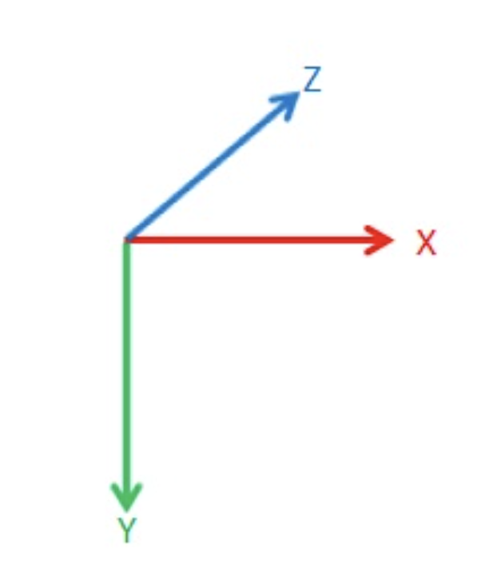
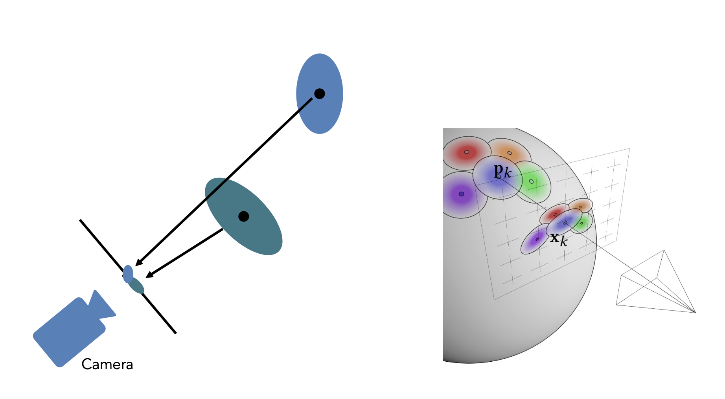
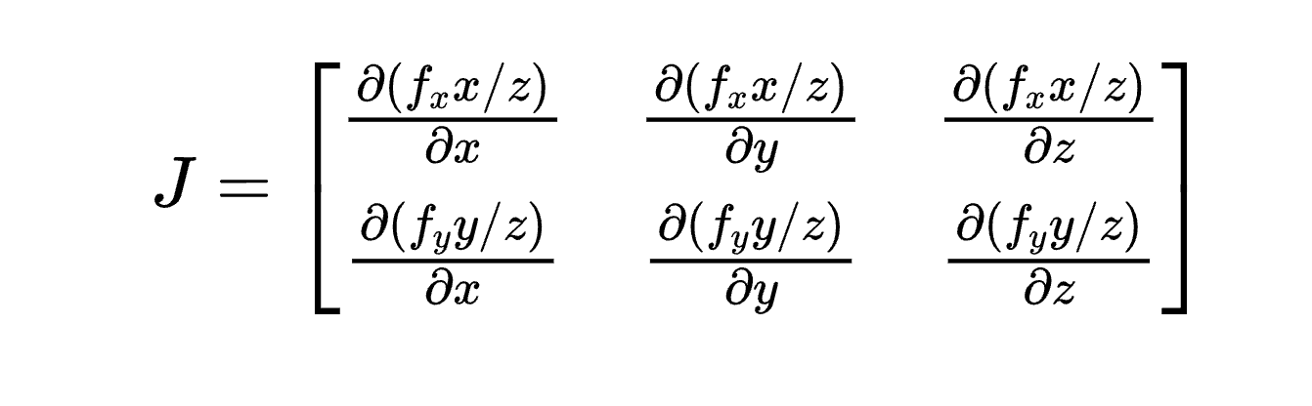
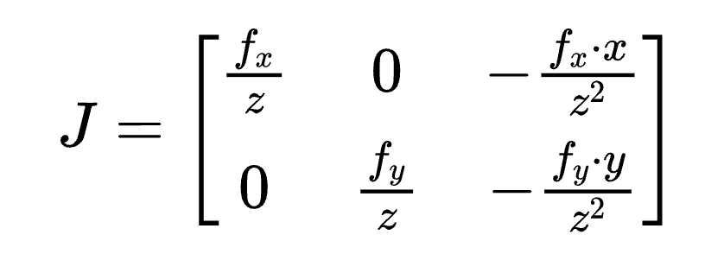
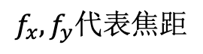
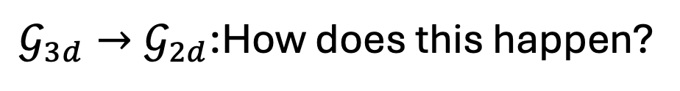
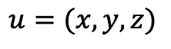
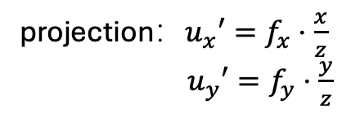
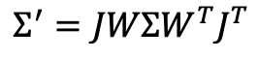
Projection Gaussian
$$u=(x,y,z)$$
$$Σ^{′}=JWΣW^{T}J^{T}$$
projection：$u_{x}′=f_{x}⋅\frac{x}{z}$
${ u}_{y}′=f_{y}⋅\frac{y}{z}$
$$f_{x},f_{y}代表焦距$$
z代表深度
$𝒢_{3d}→𝒢_{2d}$:How does this happen?
Gaussian –(linear transform)-> Gaussian
Taylor formula linearization
Just like Extended kalman filter did

Slide 15
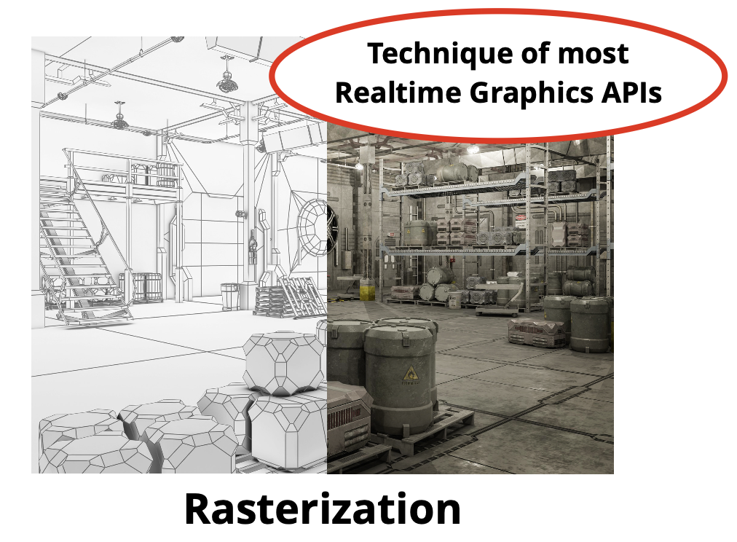
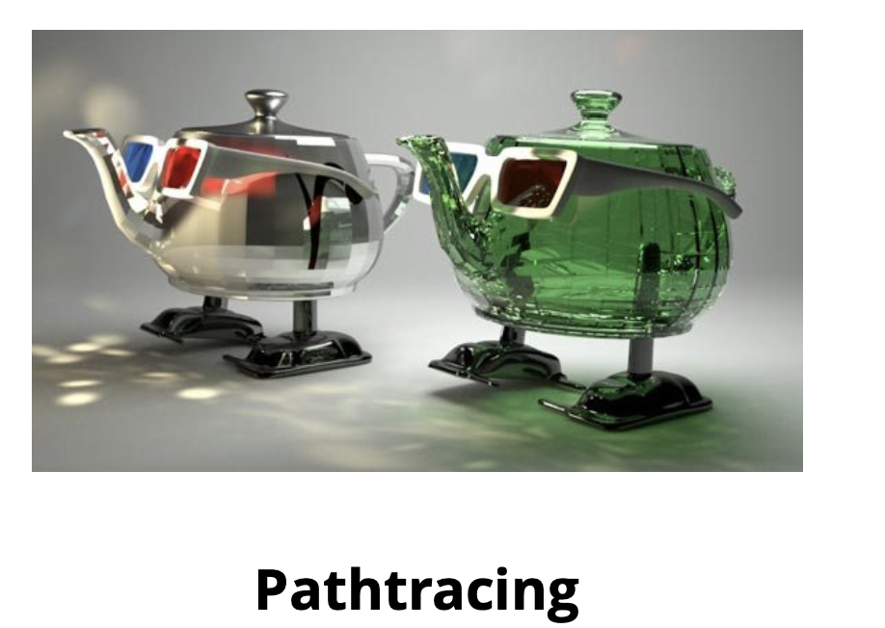
Two norms: Rasterization vs Pathtracing
GPU will like it.
Bounce simulated rays of light
throughout your scene
randomly for each pixel, and
illuminate if it eventually
intersects a light.
Transform scene geometry via
matrix operations to screen
space, then use Primitives fill
algorithm.
https://15462.courses.cs.cmu.edu/fall2019/lecture/opengl

Slide 16
Two norms with DL + geometric inductive bias
DL: Differentiable neural radiance
Colmap(SFM): Geometric inductive bias
Well, sounds robust and great, so what is the next thing?

Slide 17
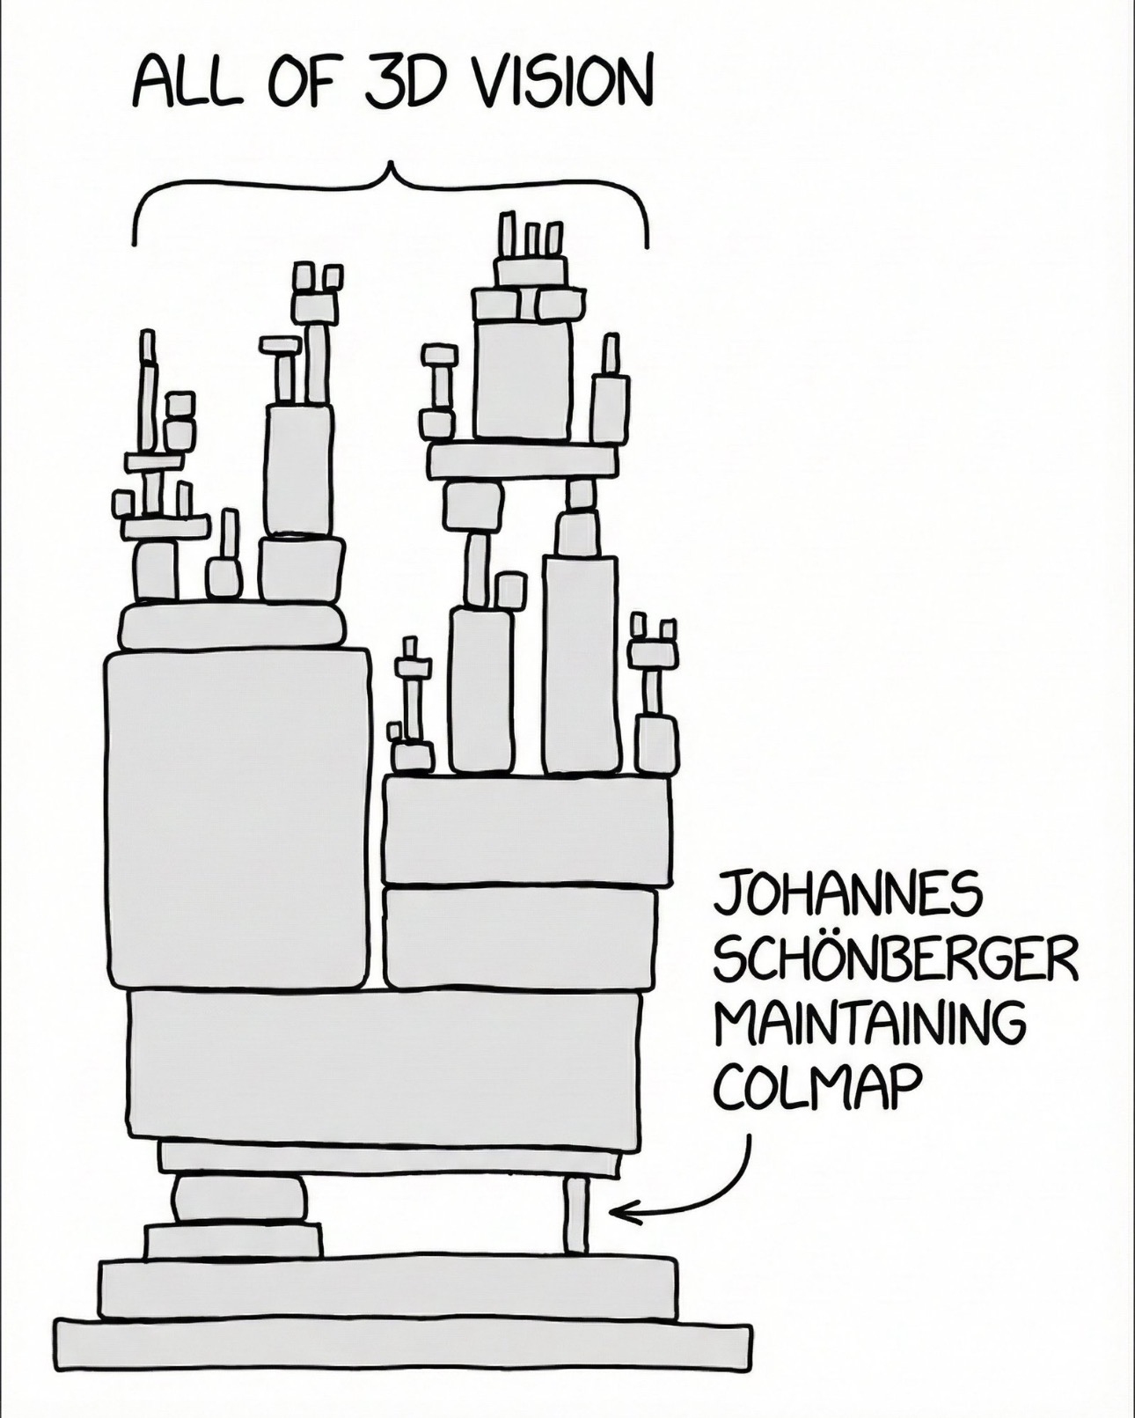
Question
在DL时代：基于传统几何的优化方法还有被大量运用吗？

Slide 18
Why Not 3D with geometric Optimization?
The Future:
end to end Only
Time-consuming and complex
Poor Compatibility with Deep Learning
Not inherently "plug-and-play"
Often non-differentiable
Are we approaching a E2E 3D foundation model?

Slide 19
